Slide 1
Object Oriented Programming

Slide 2
Reading input from keyboard
Command line arguments
Control statements
Type conversion

Slide 3
Reading input from keyboard
int a;
Scanner sc = new Scanner(System.in);
a = sc.nextInt();
import java.util.Scanner;

Slide 4
import java.util.Scanner;
class prg3
{ public static void main(String args[])
{ int a,b,c;
Scanner sc = new Scanner(System.in);
System.out.println("Enter a first number");
a = sc.nextInt();
System.out.println("Enter a second number");
b = sc.nextInt();
c = a+ b;
System.out.println("sum is :"+c);
} }

Slide 5
Command-Line Arguments
Passing information into a program during the execution is carried out by passing command line arguments to
main().
They are stored as strings in a string array passed to the args parameter of main().
//Display all command line arguments
class CommandLine
{
public static void main(String args[]) Output:
{ args[0] :this
for(int i=0; i< args.length; i++) args[1]:is
System.out.println(“args[“ + i + “]: “ + args[i]); args[2]:a
} args[3]:test
} args[4]:100
args[5]:-1
Program execution at command prompt:
Java CommandLine this is a test 100 -1

Slide 6

Control structure
class prg
{ public static void main(String args[])
{
System.out.println(“Welcome");
System.out.println(“Hello world");
System.out.println(“MIT”);
} }

Slide 7
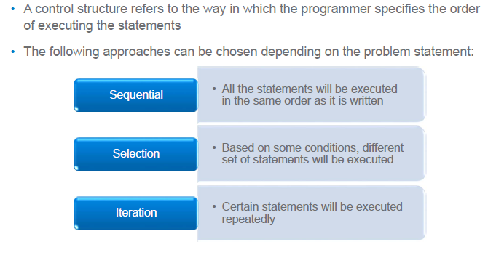
Control structures

Slide 8
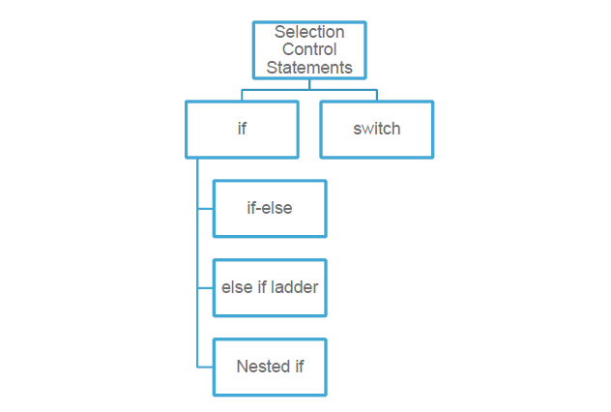
Selection Control structures

Slide 9

Selection Control structures statements
Simple if statement

Slide 10
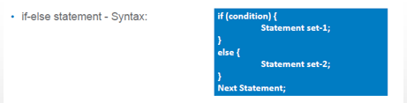
Selection Control structures statements

Slide 11
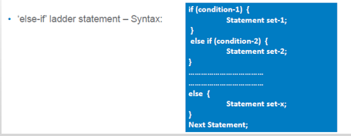
Selection Control structures statements

Slide 12
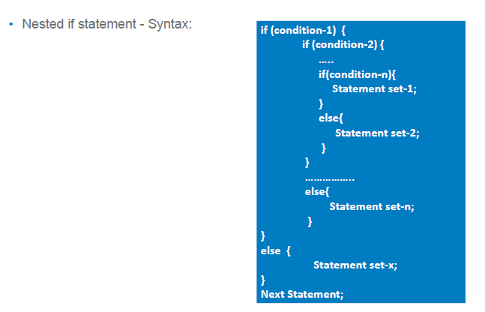
Selection Control structures statements

Slide 13
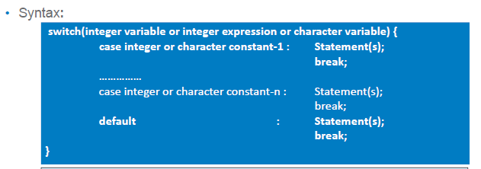
Selection Control structures - switch statement
is a selection control structure that helps to select a choice from a set of available choices.
Expression must be of type byte ,short,int or char
Case must be integer or char

Slide 14
Selection Control structures - switch statement
int number=20;
switch(number)
{
case 10: System.out.println("10");
break;
case 20: System.out.println("20");
break;
case 30: System.out.println("30");
break;
default:System.out.println("Not in 10, 20 or 30");
}

Slide 15
Selection Control structures - switch statement
int number=30;
switch(number)
{
case 10: System.out.println("10");
case 20: System.out.println("20");
case 30: System.out.println("30");
case 40: System.out.println(“40");
default:System.out.println("Not in 10, 20,30 or 40");
}

Slide 16
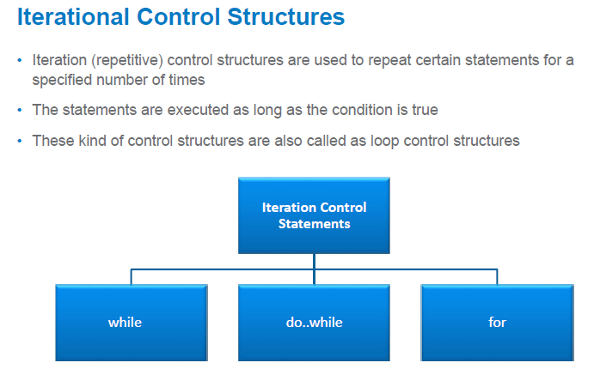

Slide 17
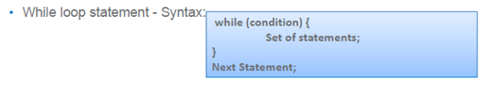
int count = 0;
while (count < 100)
{
System.out.println("Welcome to Java");
count++;
}

Slide 18

int count = 0;
while (count < 2)
{
System.out.println("Welcome to Java!");
count++;
}

Slide 19

int i;
for (i = 0; i < 2; i++)
{
System.out.println( "Welcome to Java!");
}

Slide 20
Control statements
for (type var : list)
{
System.out.println(var);
}

Slide 21
int a[] = {10,20,30};
for (int b : a)
{
System.out.println(b);
}

Slide 22
String s[]= {"anil","sunil","rahul"};
for (String b : s)
{
System.out.println(b);
}

Slide 23
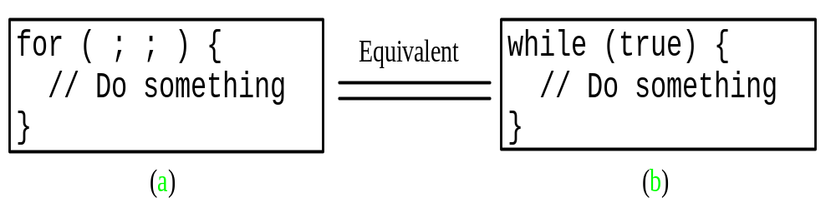

Slide 24


Slide 25

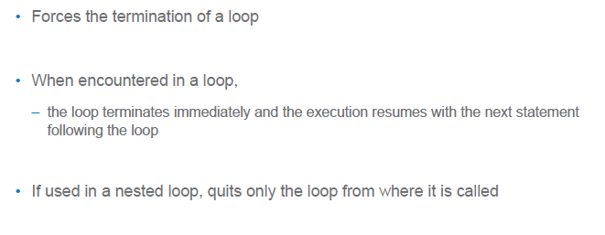

Slide 26

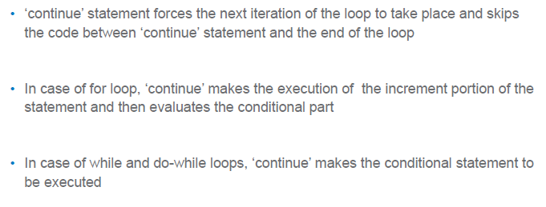

Slide 27
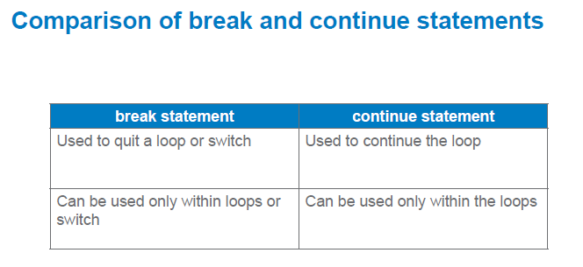

Slide 28
Labeled break and continue statement
mylabel: for(i=0;i<10;i++)
{
for(j=0;j<10;j++)
{
if(i==j)
break mylabel;
}
}

Slide 29
Labeled break and continue statement
mylabel: for(i=0;i<10;i++)
{
for(j=0;j<10;j++)
{
if(i==j)
continue mylabel;
}
}

Slide 30
Labeled break and continue statement
mylabel: for(i=0;i<10;i++)
{
for(j=0;j<10;j++)
{
if(i==j)
break mylabel
}
}
mylabel: for(i=0;i<10;i++)
{
for(j=0;j<10;j++)
{
if(i==j)
continue mylabel
}
}

Slide 31
Type casting
Process of converting one data type to another is called casting.
4 integer types can be cast into any other type except boolean.
Float and double can be cast to any other type except boolean.
Below shows which are guaranteed to result in no loss of information. (promotion type)
From To
byte short, char, int, long, float, double
short int, long, float, double
char int, long, float, double
int long, float, double
long float, double
float double

Slide 32
Automatic conversion : assigning the value of one type to a variable of different type without a cast.
byte b = 75;
int a = b;
The process of assigning a smaller type to a larger one is known as widening or promotion.

Slide 33
Explicit conversion(narrowing)
Assigning a larger type to a smaller one is known as narrowing.
type 1 var1 = (type2) var2
Ex: int a;
double b =3.4;
a= (int) b;

Slide 34
Type conversions in expressions
During evaluation of the expression, if the operands are of different types, lower type is automatically converted to higher type before the operation proceeds.
Whenever a char, byte or short is used in an expression, its value is automatically converted to int during the evaluation of that expression called integral promotion
After the automatic integral promotions are applied, the java compiler converts all operands “up” to the type of the largest operand. This is called type promotion.

Slide 35
It is on an operation-by-operation basis as described in the following type-conversion algorithm.
IF either operand is a double
THEN the other operand is converted to double
ELSE IF either operand is float
THEN the other operand is converted to float
ELSE IF either operand is long
THEN the other operand is converted to long.

Slide 36
The final result of an expression is converted to the type of the variable on the left of the assignment sign before assigning the value to it.
The following changes are introduced during the final assignment.
  1 float to int causes truncation of fractional part.
  2 double to float causes rounding of digits.
  3 long to int causes dropping of the excess higher order bits.

Slide 37
class Promote
{ public static void main(String args[])
{
byte b = 42; char c = 'a';
short s = 1024; int i = 50000;
float f = 5.67f; double d = .1234;
double result = (f * b) + (i / c) - (d * s); // next slide
System.out.println("result = " + result);
}}

Slide 38
First subexpression, f * b, b is promoted to a float and the result of the subexpression is float.
In the subexpression i / c, c is promoted to int, and the result is of type int.
Then, in d * s, the value of s is promoted to double, and the type of the subexpression is double.
Finally, these three intermediate values, float, int, and double, are considered.
The outcome of float plus an int is a float. Then the resultant float minus the last double
is promoted to double, which is the type for the final result of the expression.

Slide 39
byte a=2, d=3;
short c;
c= a+d;

Slide 40
byte a=2, d=3
short c;
c= a+d;
Error: found: int required short. // error: incompatible types: possible lossy conversion from int to short
//
------------------------------------------------------------------------------------------------
Correct:
byte a=2, d=3
short c;
c= (short)(a+d)

Slide 41
byte b;
int i=258;
b = (byte)i;
System.out.println(b);

Slide 42
byte b;
int i=258;
b = (byte)i;
System.out.println(b);
OUTPUT: 2

Slide 43
float f=23.99f
int i=(int)f;
System.out.println(i);

Slide 44
float f=23.99f
int i=(int)f;
System.out.println(i);
OUTPUT: 23

Slide 45
byte b1 =1;
byte b2 = 2;
byte b3 = b1 * b2;
System.out.println(b3);
Error: incompatible types: possible lossy conversion from int to byte

Slide 46
byte b=50;
short t;
t = b
NO ERROR
-----------------------------------------------------------------------------------------------
byte b=50;
short t;
t = b - 1
ERROR : found : int
required : short

Slide 47
int n=386;
byte b;
b = (byte)n;
System.out.println(b);

Slide 48
int n=386;
byte b;
b = (byte)n;
System.out.println(b);
Output : -126 // next slide

Slide 49
OUTPUT : -126
386= 110000010
10000010
01111101
1
--------------
2s complement 01111110 = 126
So value is -126

